Slide 1
Contemporary Macedonian Art

Slide 2
The development of modern art in Macedonia
The peculiarities of the dramatic history of the Macedonian nation determined the characteristics of the development of all its national culture.
After the brilliant blooming of medieval Macedonian art, the five-century slavery under the Ottoman Empire set in.

Slide 3
During that difficult period in the history, there was a significant decline of the church art work in Macedonia, which could be developed within the narrow frames of the provincial forms of post Byzantium religious art.
However, unlike some other areas, there is no consistent stylistic development from the Renaissance to the Impressionism and beyond.

Slide 4
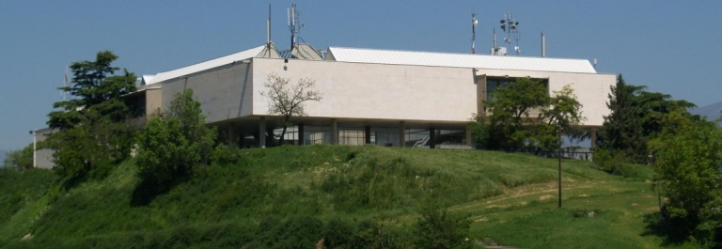
The Contemporary Art Museum of Macedonia, Skopje

Slide 5
Main Macedonian modern artists
Nikola Martinoski
Dimitar Pandilov Avramovski
Borislav Traikovski
Vangel Kodzoman
Dimitar Kondovski
Lazar Lichenoski
Patar Mazev
Ivan Velkov
Vasko Tashovski
Bogoljub Ivkoovikj
Ljubomir Belogaski

